Slide 1

Risk of developing Type II Diabetes
Using Data Science models, I’m attempting to predict the risk of developing Type 2 diabetes given an Individuals vital health signs.
Karun Siddana
July 22nd, 2015

Slide 2
Problem Statement
There is an increasing growing problem of obesity and hypertension in the United States that leads to Type 2 diabetes. A sure shot test for type 2 diabetes has not been developed due to the complexities in the disease.
Unlike Type 1 diabetes which can be detected at birth, type 2 diabetes is dependent on the individuals lifestyle, exercise component, nutrition and genetic makeup.
Early detection of the indicators of Type 2 diabetes would allow us to avoid bad food habits and prevent/mitigate the risk of developing type 2 diabetes.

Slide 3
Data
Using the following indicators, I am trying to predict the outcome, whether a person is positive for diabetes.
Total Cholesterol Level
Blood Glucose Level (stab.glu)
HDL
Glycosylated Hemoglobin (Response)
Age
Gender
Body Frame
Systolic Blood Pressure levels
Waist Size
Hip Size

Slide 4
Data Collection
The Data used was from the Department of Biostatistics at the Vanderbilt University
http://cs-people.bu.edu/dgs/courses/cs105/hall_of_fame/awm.html

Slide 5
Data Exploration
Firstly I plotted several graphs to understand the correlation between the indicators and the response.
Total Data Points
Total Patients = 403
What kind of data do I have here?
Male: 169
Female: 234

Slide 6
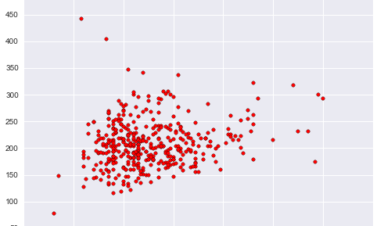
Plot – hdl vs chol

Slide 7
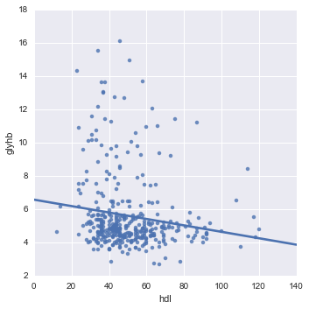
Plot – hdl vs glyhb
X-axis: High Cholesterol
Y-axis: Glycosylated Hemoglobin

Slide 8
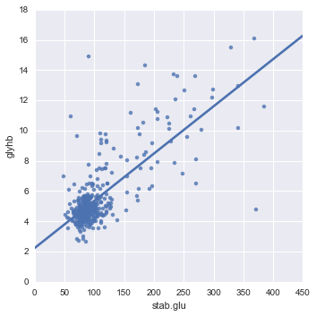
Plot – stab.glu / glyhb
X-axis: Blood Glucose Level
Y-axis: Glycosylated Hemoglobin

Slide 9
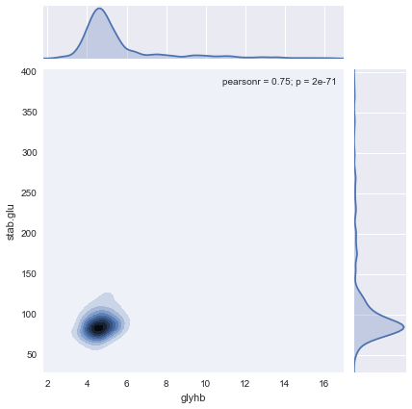
Kernel Density Plot – hdl vs glyhb
X-axis: Glycosylated Hemoglobin
Y-axis: Blood Glucose Level

Slide 10
Logistic Regression
Confusion Matrix
[110 0 ]
[9 14]
Accuracy = 0.932330827068
Specificity = 1.0
Sensitivity = 0.608695652174

Slide 11
Next Steps
I have another set of data from http://www4.stat.ncsu.edu/~boos/var.select/diabetes.html
I plan on comparing this data with my model. It doesn’t have all the columns that I have.
Plan on performing K-Means clustering
Using Linear Regression, determine the P-Values
Understand the Confusion Matrix
Perform Naïve Bayes Classification

Slide 12
Linear Regression

